Slide 1
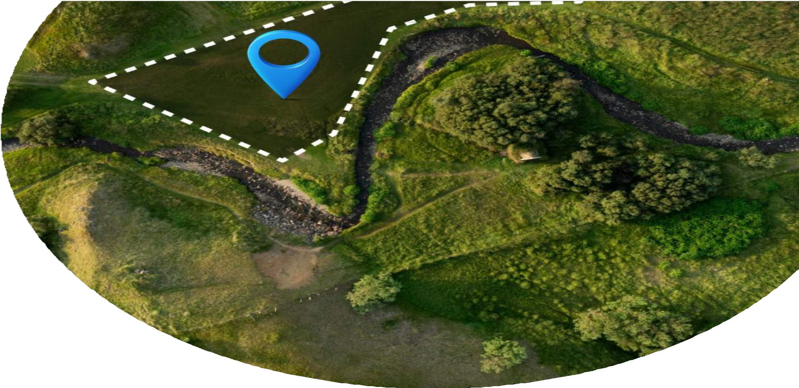
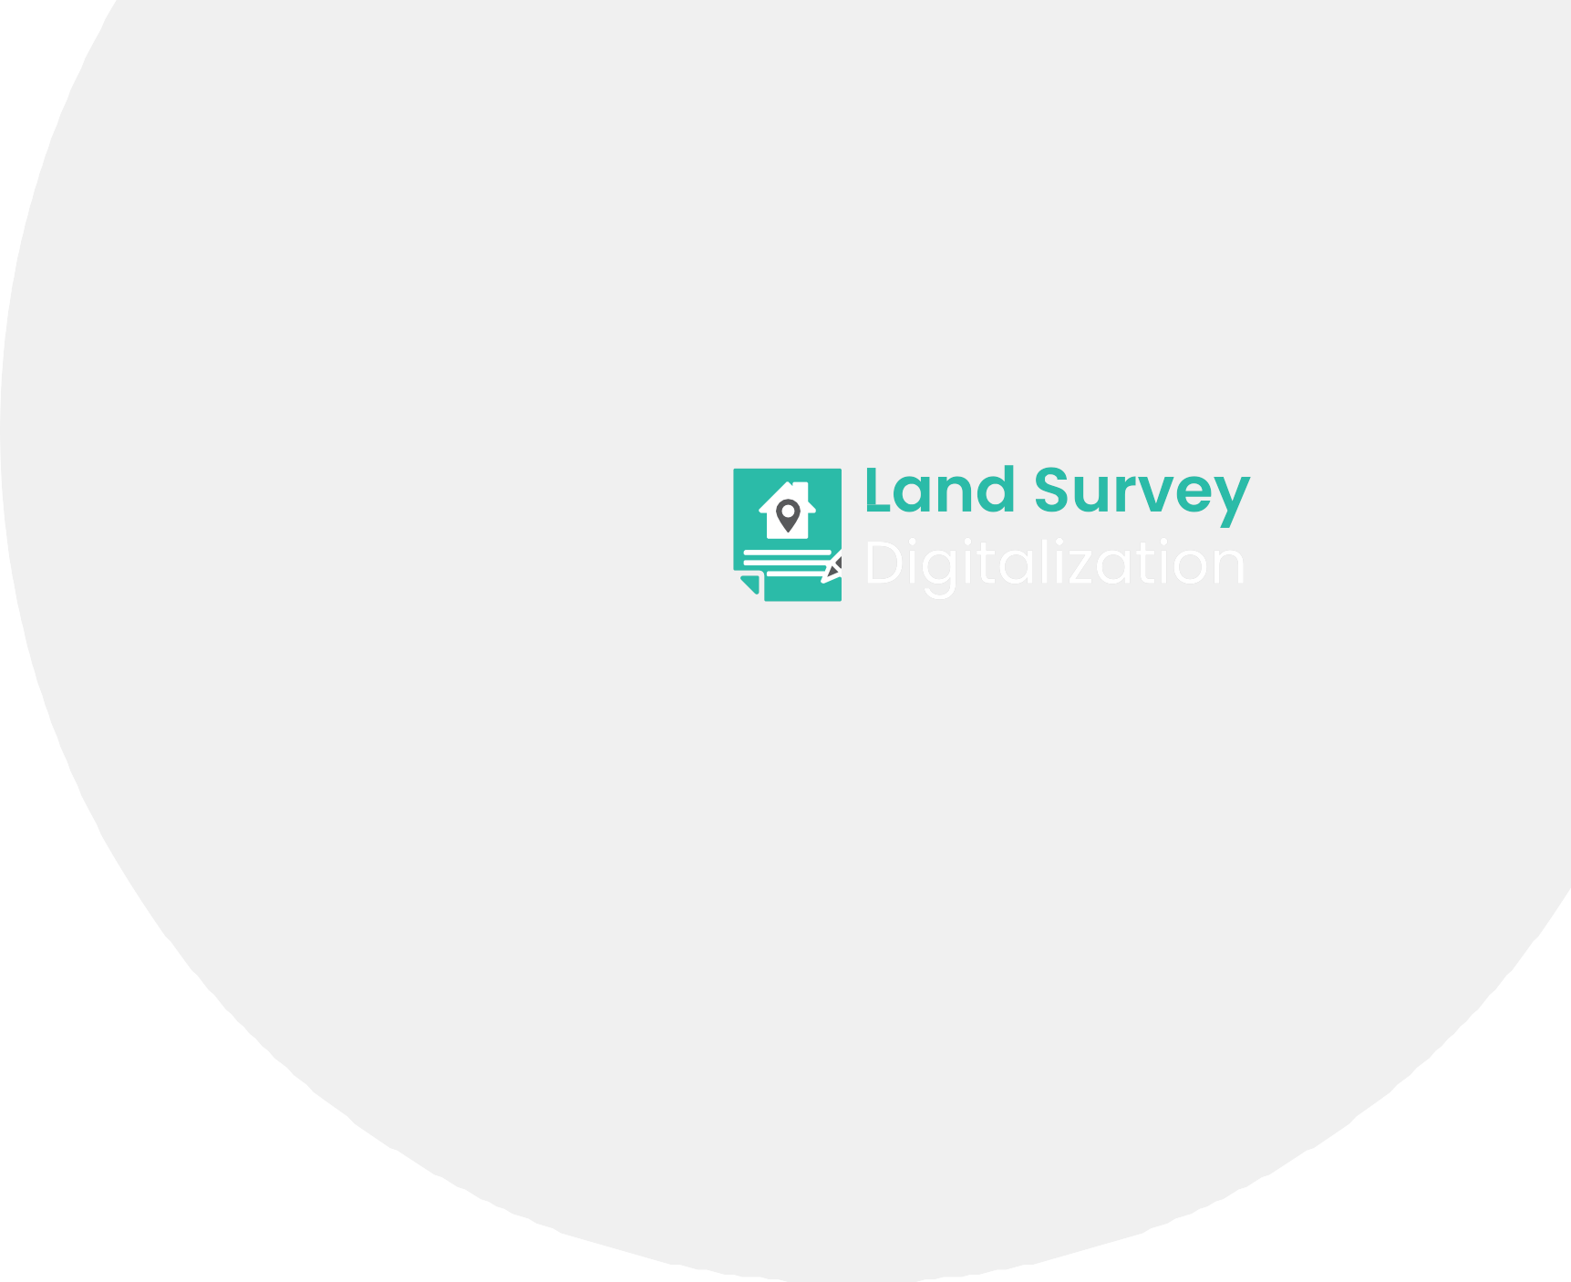
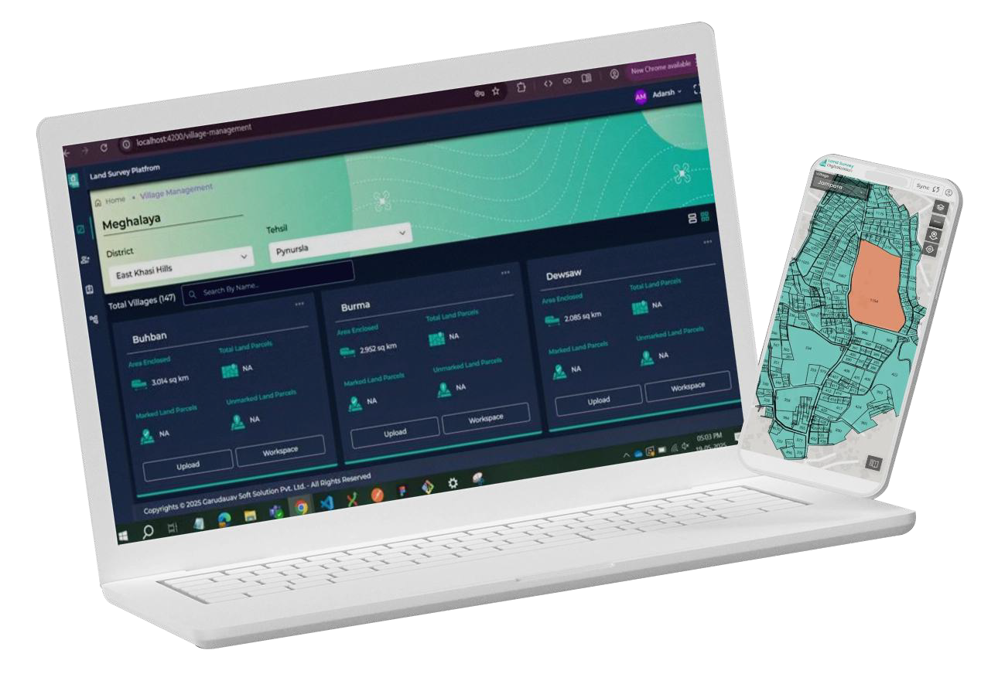

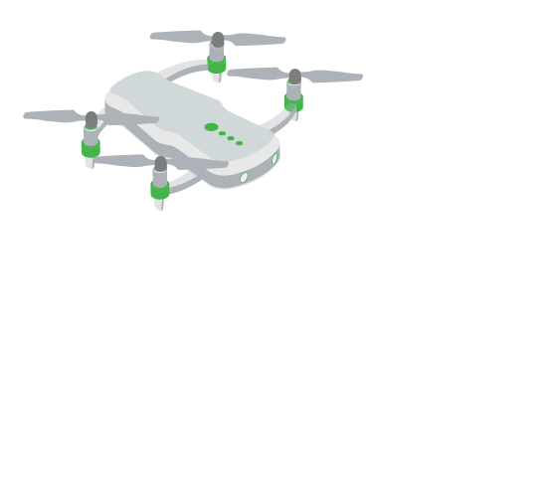
Land Survey App & Web Presentation
Streamlining Land Parcel Surveying for the Modern Era

Slide 2




Introduction
In a world demanding efficiency and precision, land surveying remains critical yet challenging. Our Land Survey App and Web System transforms this process with an integrated web and mobile platform—empowering surveyors, managers, and stakeholders to deliver results faster and smarter.

Slide 3


The Challenge
Traditional surveying struggles with:
Fragmented Data: Disjointed systems complicate management.
No Real-Time Sync: Delays hinder timely decisions.
Manual Reporting: Slow, error-prone processes waste time.
Limited Geospatial Tools: Gaps in integration stall progress.
These inefficiencies slow projects and modernisation efforts.
Our Solution
A unified platform for surveying, editing, and reporting:
Web Interface: Centralised control for admins.
Mobile App: Android-based, offline-ready for field surveyors.
Geospatial Power: Seamless integration with GeoServer and AWS S3.
Real-Time Insights: Sync and track progress instantly.
Automated Reports: Generate detailed PDFs on demand.

Slide 4





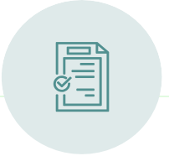
Key Features
User Management
Assign surveyors to villages and parcels effortlessly.
Interactive Maps
Visualise and edit parcel data with Mapbox.
Offline Mode
Capture data anywhere, sync when connected.
Progress Tracking
Monitor surveyor activity in real time.
PDF Report Generation
Export parcel details, images, and updates instantly.

Slide 5




Who Benefits?
Land Surveyors
GIS Specialists
Government Land Departments
Civil Engineers and Urban Planners
Agricultural Agencies
Project Managers
Data Analysts
Construction & Real Estate Firms

Slide 6































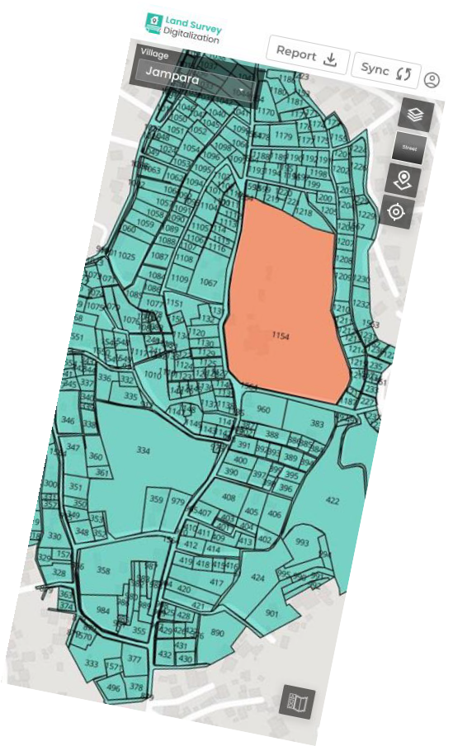




















End-User Advantages
Centralised Workflow: Minimise manual effort and errors.
Field-to-Office Sync: Seamless coordination.
Live Tracking: Stay ahead with real-time updates.
Smarter Decisions: Leverage automated reporting.
Boosted Efficiency: Offline capabilities save time.

Slide 7
Technical Integrations
Built on robust technology:
GeoServer
Advanced spatial data handling.
AWS S3/EC2
Secure, scalable storage.
GIS Tools & APIs
: Enhanced mapping and analytics.

Slide 8


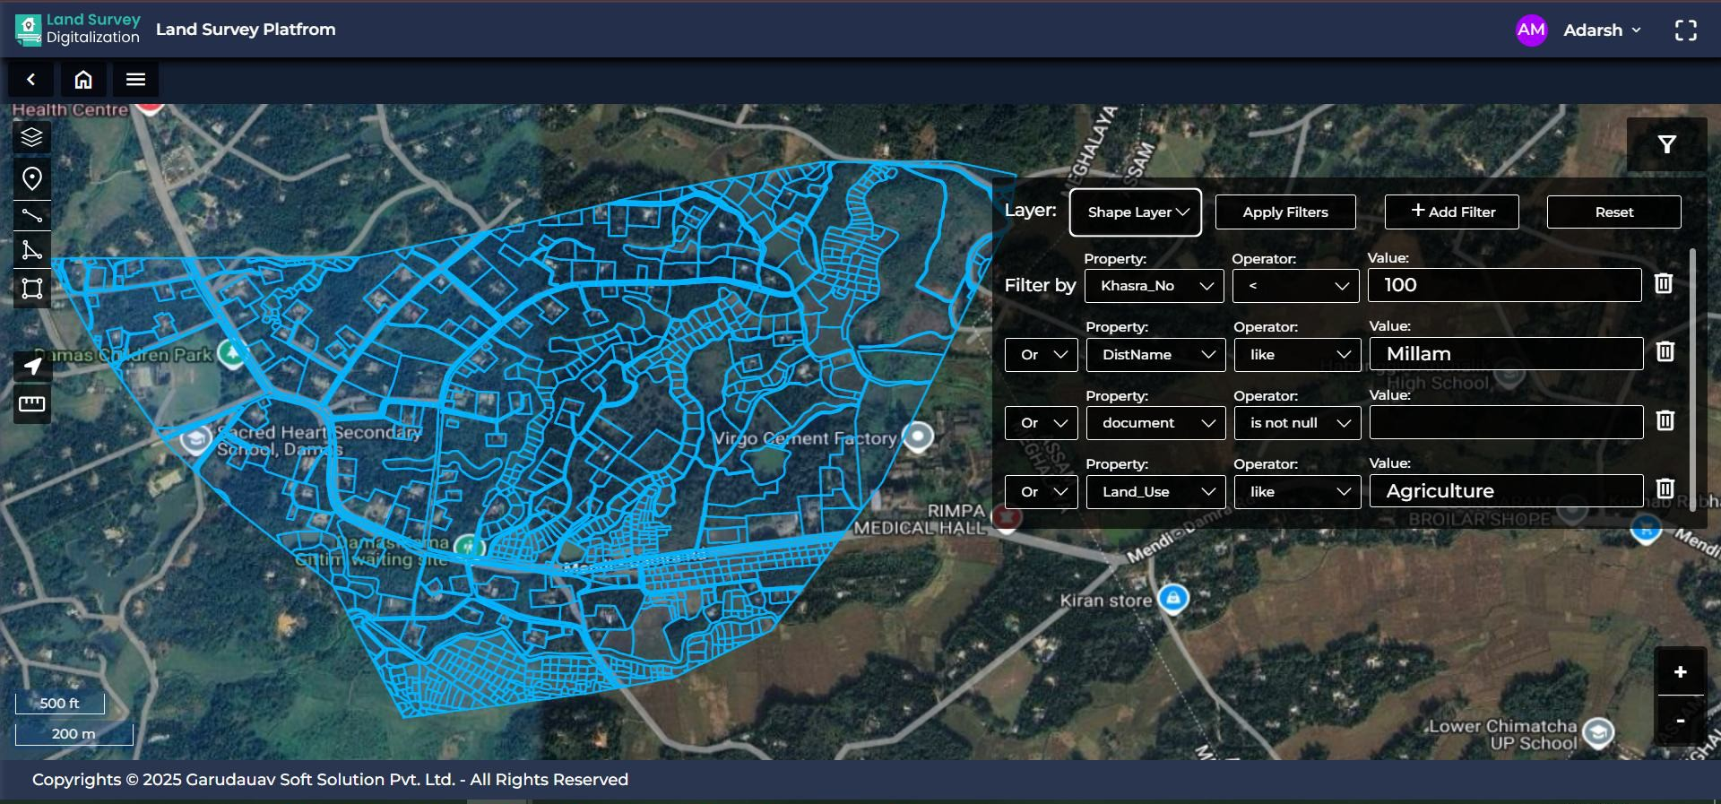


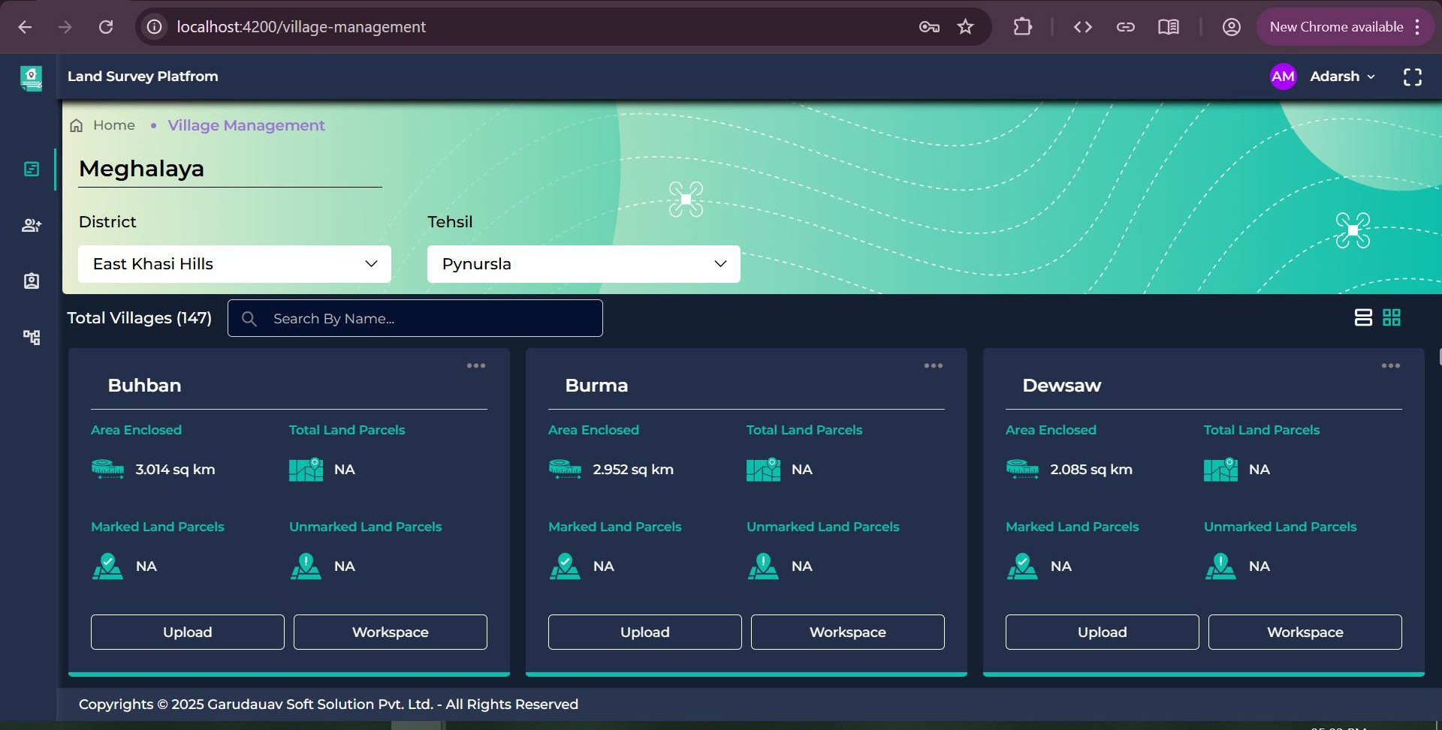


Engagement Models
Web Dashboard for Admin & Supervisors
Role-based access tailored for diverse user groups
Mobile App for Field Surveyors

Slide 9











About Us
Since 2017, we’ve led geospatial innovation:
550+
Around
1,70,000 KMs
highways surveyed & inspected
Around
7,000 KMs
of railway tracks surveyed
Around
1,15,000 Sq Kms
of urban land mapped
Around
4,00,000 hectares
of dams & irrigation projects surveyed
Around
1,60,000 CKMs
of power T&D lines inspected
Projects delivered
10
Verticals we serve
Around
2,500 Sq Kms
of mines surveyed
Around
110
historic monuments scanned and architectural drawings evolved
Around
2,000 Sq Kms
of forests mapped
Around
5,000 MW
of solar thermography completed
Around
5,000 KMs
of oil & gas pipelines inspected
100+
Satisfied Customers

Slide 10
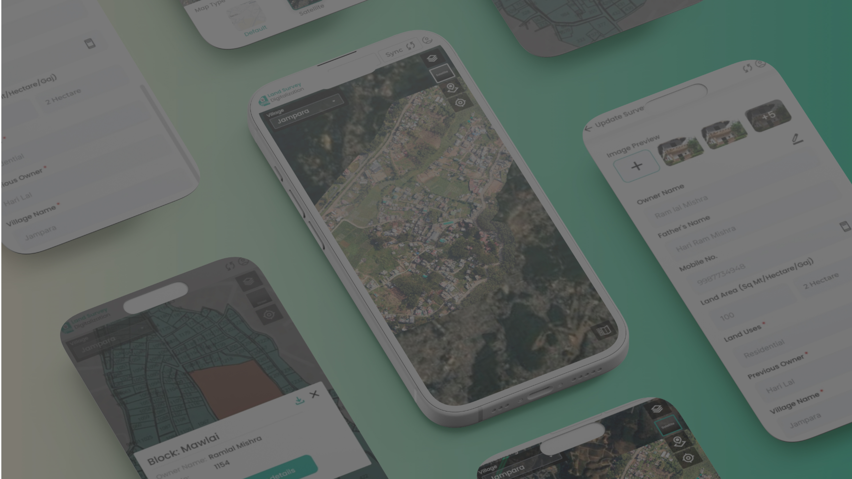
Conclusion
The Land Survey App and Web System isn’t just a tool—it’s a revolution in land management. Simplify data collection, enable offline workflows, and unlock actionable insights with ease. Your projects deserve precision and speed.

Slide 11



Trusted by Leaders
Endorsed by:
KHADC
GHADC
JHADC
Khasi Hills Autonomous District Council
Garo Hills Autonomous District Council
Jaintia Hills Autonomous District Council

Slide 12





Contact Us
Ready to transform your surveying?
Assotech Business Cresterra: Unit No. 301 to 318, Third Floor, Tower 2, Plot 22, Sector 135, Expressway Noida, Uttar Pradesh 201304
www.garudauav.com
www.sales@garudauav.com
+91-9354915060

